Slide 1

Experiment 3: Clock
Navarro, Rod Geryk C.
CPE160P - 4– A1

Slide 2
OBJECTIVES
To be able to demonstrate how a real clock works.
To be able to apply embedded system in displaying hours and minutes using Seven-segment display, and switches.
To be able to apply what you have learned in Microprocessor and Logic Circuits and Switching Theory.
To be able to apply embedded system in a simple handshaking using Arduino Kit.

Slide 3
MATERIALS
Arduino Kit
2 10k ohm Resistors
4 1k ohm Resistors
2 Buttons
Breadboard
4-digit 7-Segment Display
Arduino Uno
Laptop

Slide 4
PROCEDURE
Create a working 4 Digit 7-Segment Display circuit using Arduino.
Create number patterns in the Arduino IDE.
3. Create Hour and Minute increment/decrement in the Arduino IDE.
4. Debug the code

Slide 5
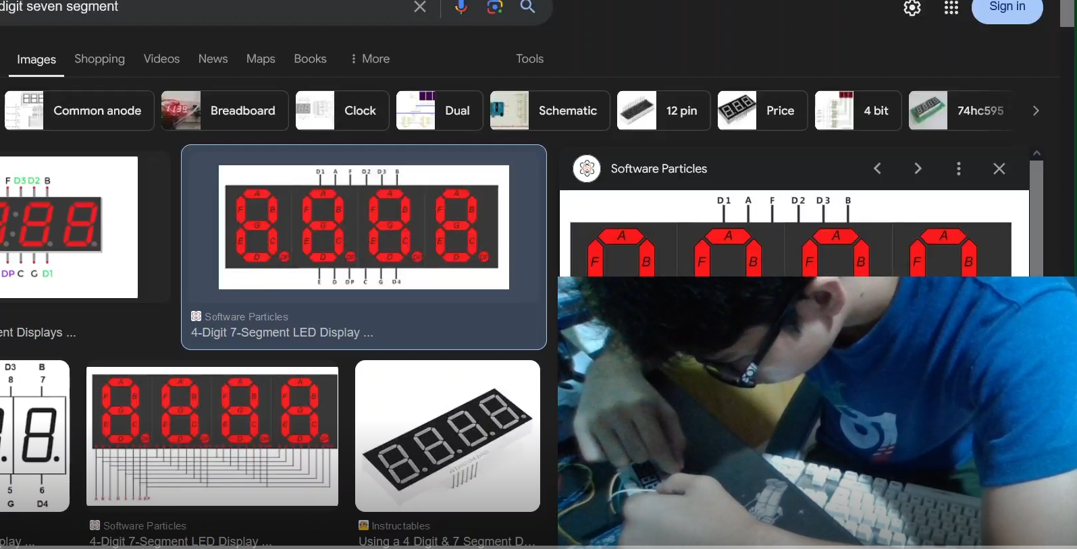
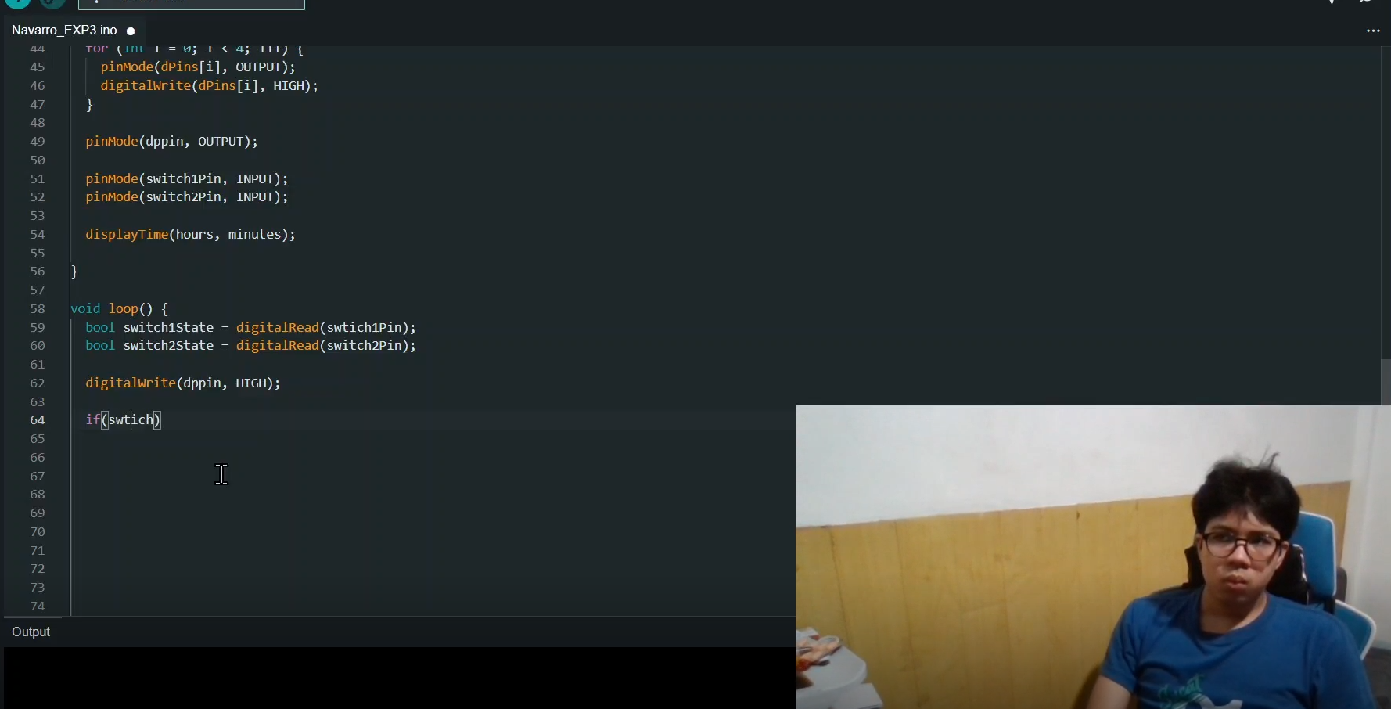
PROCEDURE

Slide 6
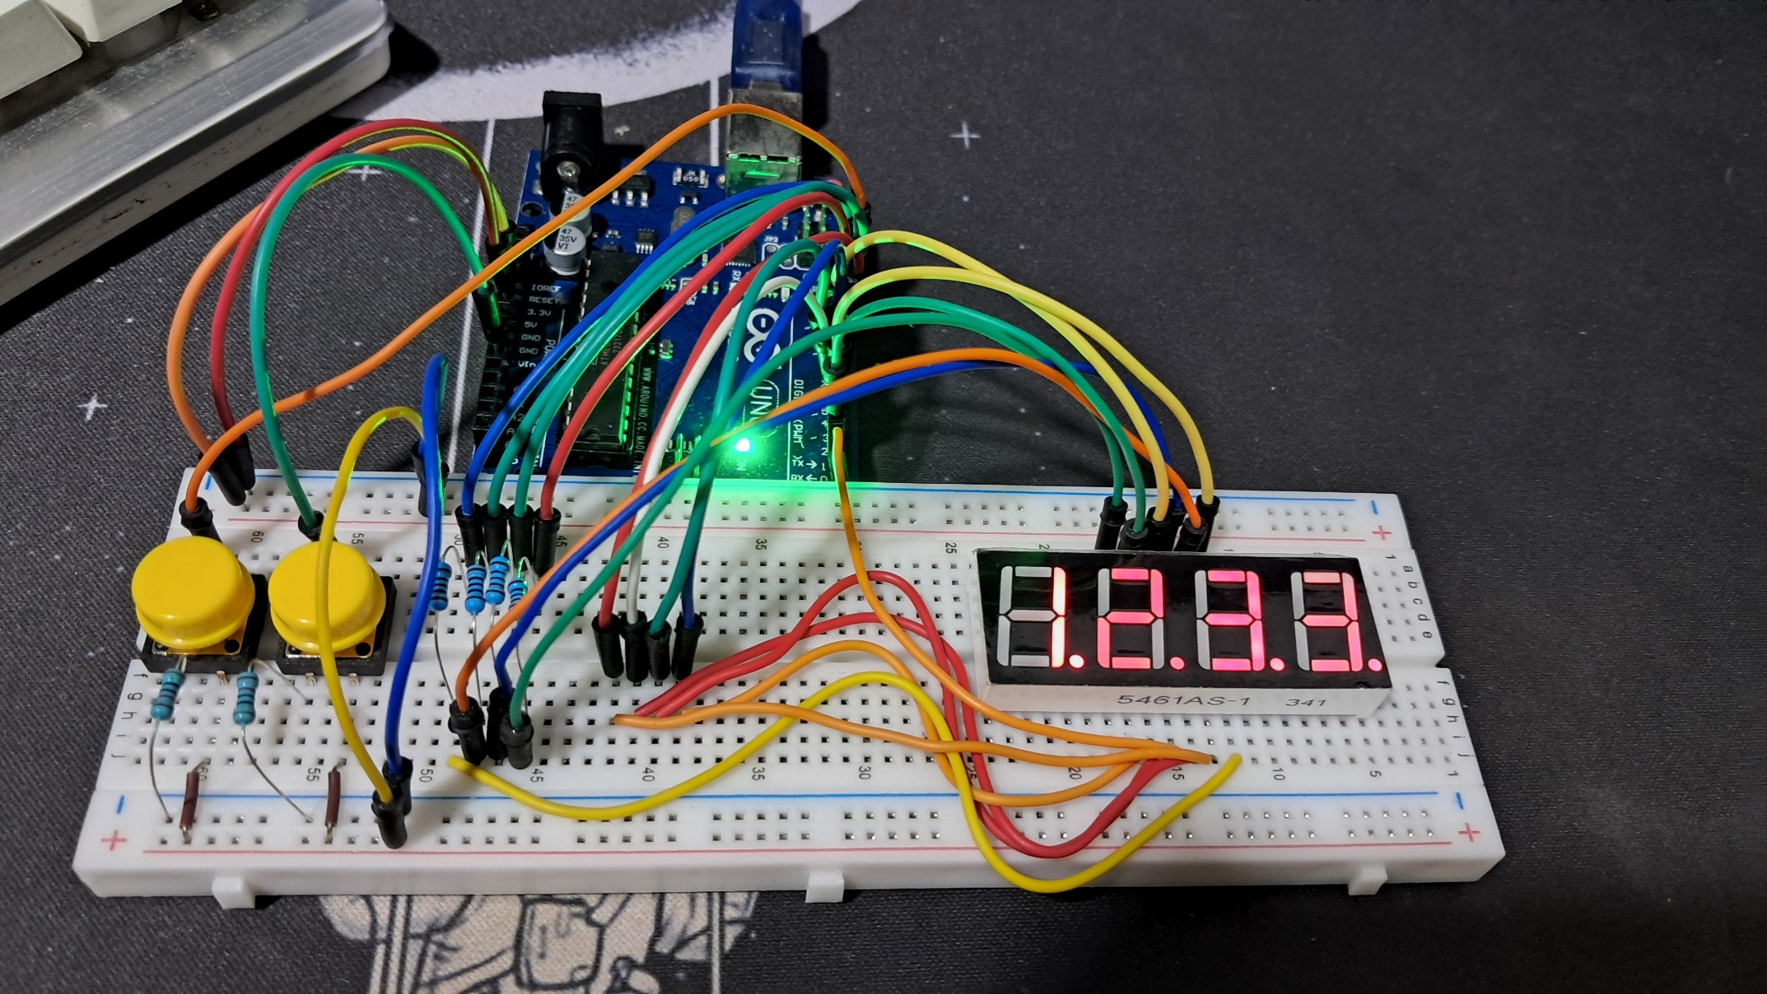
PROCEDURE

Slide 7
THANK YOU!

